Slide 1
ITS Schematic Check
29 Feb 2024
Nuvoton Technology Singapore
*Schematic and software flow discussed/stated in this document are for reference consideration only.
*Customer will need to perform detail verification and validation to ensure functionality and reliability of the design.

Slide 2
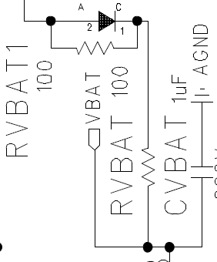

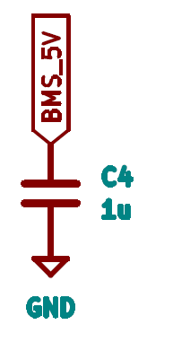
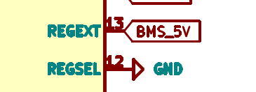
 | Items | Comment and Remarks
1 2 | BMIC Circuit - VBAT REGEXT, REGSEL | Insert RVBAT ~ 100ohm for Hotplug protection Insert C (typically about 1uF) for stable voltage Thank you for the suggestion, we will consider it Your STM MCU is 3.3V supply, our BMIC REGEXT have the option of 3.3V output (by pull high the REGSEL pin) Thank you for the recommendation, we decided to use this feature. Any reason why need to use 5V and drop using LDO externally? actually no, There was some miscommunication in our team. We are really sorry. This cap has to be placed near to REGEXT (pin 13) on PCB to ensure stable voltage. Thank you for the suggestion, we will consider it
3

Slide 3

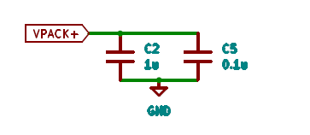

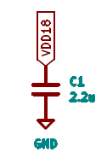

 | Items | Comment and Remarks
3 4 | Vpack+ VDD18 | Optional: suggest place tenth of ohm of resistor, for filtering. Thank you for the suggestion, we will consider it Suggest place VDD18 output Cap near BMIC for best ESD/EMC consideration Thank you for the suggestion, we will consider it Bigger cap might be needed for ESD EMC consideration, 4.7uF or higher. Thank you for the suggestion, we will consider it
RVpack
Pack+
1

Slide 4
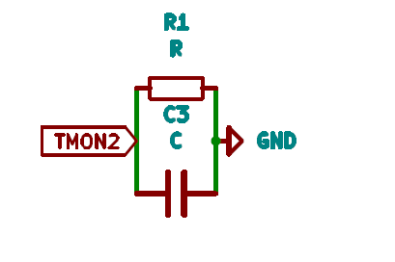
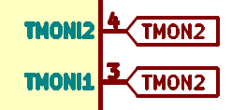
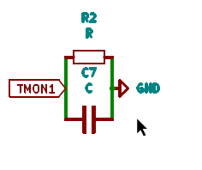

 | Items | Comment and Remarks
5 6 | TMONI VPC | This should be TMON1? How many channel of temperature sensor you need? Please advise the intended temperature range? yes, it’s mistake, we use 2, one is for the heatsink and the other for the Rsense C of 1nF is recommended Thankyou for the recommendation, we will consider it Is this resistors or thermistor? What type of thermistor you plan to use? thermistor, we have a plan to use NTC type with value less than 50K 47kohm Resistors pulled low is needed to measure low temperature. Thankyou for the recommendation, we will consider it. Currently we only intended to measure from -10 to 85 degree celcius 1) Our BMIC need >4V at VPC and 5ms pulse to wake up. How do you plan to supply to VPC? We plan to supply VPC from the VPACK directly. but, according to datasheet we would to pull down VPC pn after few milliseconds can we use monostable circuit?, or maybe we can ignore this recommendation?
3
2
1
2
3
2

Slide 5
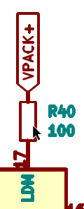
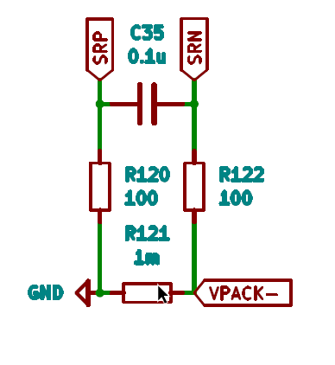

 | Items | Comment and Remarks
7 8 | LDM Current sense circuit | Are you using Load Detection (LDM) feature?. Yes, we plan to use it. SRP and SRN Sensing lines have to be drawn side by side on the same PCB layer Thank you for the suggestion, we will consider it Wide line width to be drawn base on desired current Thank you for the suggestion, we will consider it Add Left and right common mode Capacitor, suggest 100nF Thank you for the suggestion, we will consider it
3
1
3
2

Slide 6
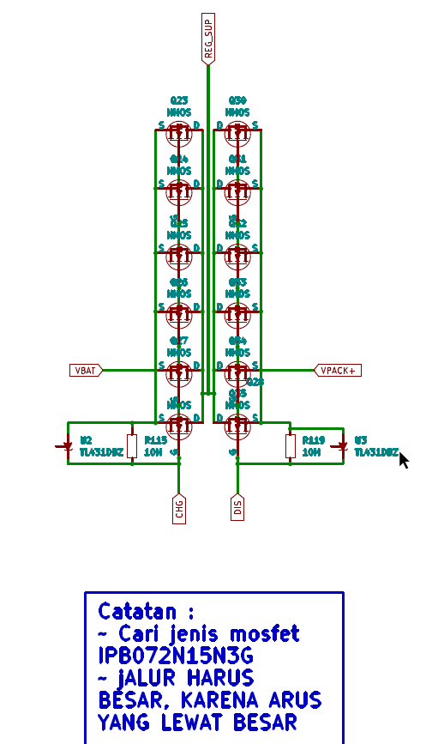
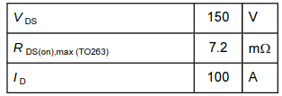
 | Items | Comment and Remarks
9 | CHG & DIS Circuit | Question: Is the MOSFET (IPB072N15N3G) tested for the 22 cells battery operation? it is not tested for 22 cells. But we already use this MOSFET in the previous design. Question: How much is the Load/charge current needed? power : 5KW up to 10 KW voltage : 72V current : 70 up to 140 A Question: Any requirement for the MOSFET on/off speed? there is no requirement Each FET should have gate balance resistor to reduce FET unbalance ringing, ~tenths of ohm Thank you for the suggestion
1
4

Slide 7
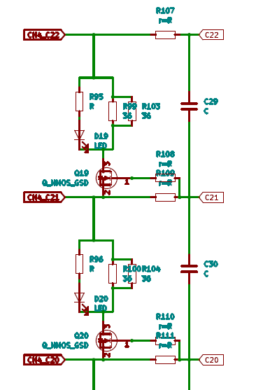
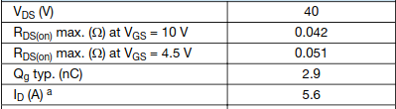
 | Items | Comment and Remarks
10 | Cell Balancing Circuit | Question: What is the battery cell voltage you plan to support? li-ion 18650 (3.7v) Question: What is the Rg value? 1k is value of Rg, we got this design from the nuvoton evaluation board Just need to ensure external NMOS FET and Rcb handle the power dissipation from the Icb current design. Use high voltage NMOS type like 40V, 50V etc to sustain hotplug stress, we consider to use NMOS Si2318CDS Vishay These LEDs are for demonstration purpose only. In actual application, you may not need LED indicator during cell balancing. Cell balance ON/OFF status can be read back from our internal registers. thankyou for the information, we consider to keep it.
4
3
2
4
3
2

Slide 8
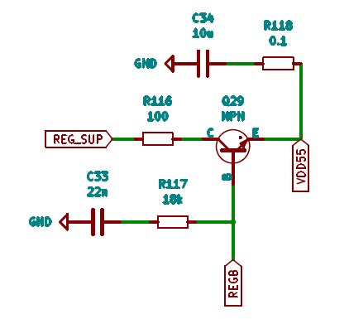

 | Items | Comment and Remarks
11 12 | VDD55 at regulator circuit | VDD55 resistor - Use high power type package, 2W Thank you for the suggestion, we will consider it CVDD need be same voltage with the MCU supply so that SPI can communicate. The STM MCU is 3.3V supply, please change to 3.3V. Thank you for the correction, we will change it Insert cap (suggest 0.1uF) for noise filter. done Thank you for the suggestion, we will consider it
1
2

Slide 9
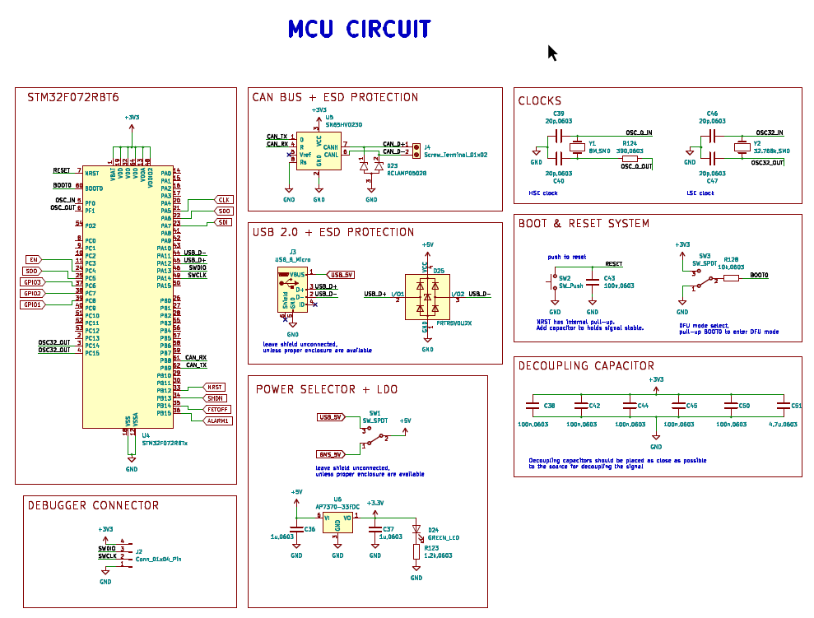
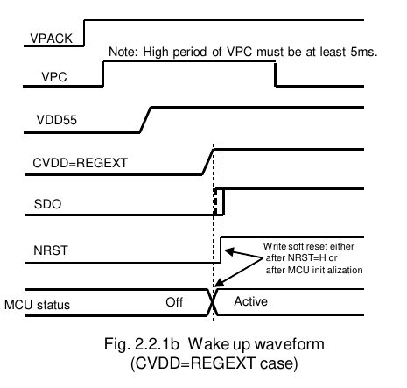
 | Items | Comment and Remarks
13 | MCU Circuit | Can you help to explain your MCU power up sequence? For example, how you supply power to MCU? We plan to follow this power up sequence method. we consider to use CVDD=REGEXT case How do you plan to wake up the BMIC from the MCU? we plan to wake up bmic directly from the vpack, but we still had a problem to perform this task can we use monostable circuit?, or maybe there are other recommendation?

